Slide 1
Presentation brief for MCT’s
Title of presentation | Understanding LUIS
Presentation length | 90 minutes.
Audience | Azure AI Engineers, Azure Developers.
Purpose | Introduce LUIS Understand how to Create a LUIS Service in Azure Understand key LUIS concepts like Intents and Utterances
(think) Student key takeaways | The student should understand what LUIS is The student should understand how to create a LUIS service in Azure The student should have a grasp of the concepts of intents, utterances, and entities
(feel) Student desired mindset | The student should understand how to use LUIS to provide natural language understanding for an AI application
(do) Student outcomes | The student should be able to create a LUIS service The student should be able to create intents, utterances, and entities in their LUIS service
More information | For course feedback, please use the MCT forums

Slide 2

AI-100T01A: Module 04: Language Understanding with LUIS

Slide 3
Agenda
Introducing Language Understanding
Create a LUIS Service
Build Intents and Utterances in LUIS
Lab: Implement the LUIS Model

Slide 4













Lesson 01
Introducing Language Understanding
Data
Cloud
AI

Slide 5
Lesson Objectives
L01 – Introduce LUIS
L02 – Introduce Intents, Utterances, and Entities
L03 – Understand LUIS Benefits
L04 – Learn Best Practices for LUIS

Slide 6
Introduction
LUIS makes use of three key aspects for understanding language:
Intent- An intent represents a task or action the user wants to perform. It is a purpose or goal expressed in a user's utterance.
Utterance - Utterances are input from the user that your app needs to interpret.
Entities - The entity represents a word or phrase inside the utterance that you want extracted.

Slide 7
Benefits of LUIS
Natural Language - Designed to identify valuable information in conversations, LUIS interprets user goals (intents) and distills valuable information from sentences (entities), for a high quality, nuanced language model.
Integrated Learning - Powerful developer tools are combined with customizable pre-built apps and entity dictionaries, such as Calendar, Music, and Devices, so you can build and deploy a solution more quickly.
Ongoing Learning - Active learning is used to continuously improve the quality of the natural language models. Once the model starts processing input, LUIS begins active learning, allowing you to constantly update and improve the model.

Slide 8
Best Practices
Microsoft recommends following an app authoring process as a best practice when implementing LUIS for an AI app or bot. There are five discreet steps involved in the process:
Build your language model
Add some training example utterances (10-15 per intent)
Publish the model
Test the newly published model
Add features as necessary based on testing

Slide 9
Lesson 02
Create a LUIS Service
Data
Cloud
AI

Slide 10
Lesson Objectives
L01 – Understand how to Create a LUIS Service
L02- Explore LUIS Considerations
L03 – Guided Walkthrough, Create a LUIS Service

Slide 11
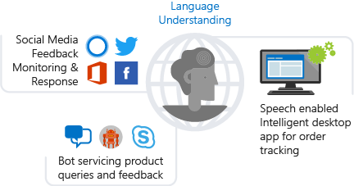
Introducing the LUIS Service
A cloud-based API service that applies custom machine-learning intelligence to a user's conversational, natural language text to predict overall meaning, and pull out relevant, detailed information

Slide 12
Considerations for LUIS
Understand your Domain
Plan your Intents
Create Example Utterances for Each Intent

Slide 13
Walkthrough – Creating a LUIS Service

Slide 14
Lesson 03
Build Intents and Utterances
Data
Cloud
AI

Slide 15
Lesson Objectives
L01 – Understand Intents, Utterances, and Entities
L02 – Guided Walkthrough, Creating Intents and Utterances

Slide 16
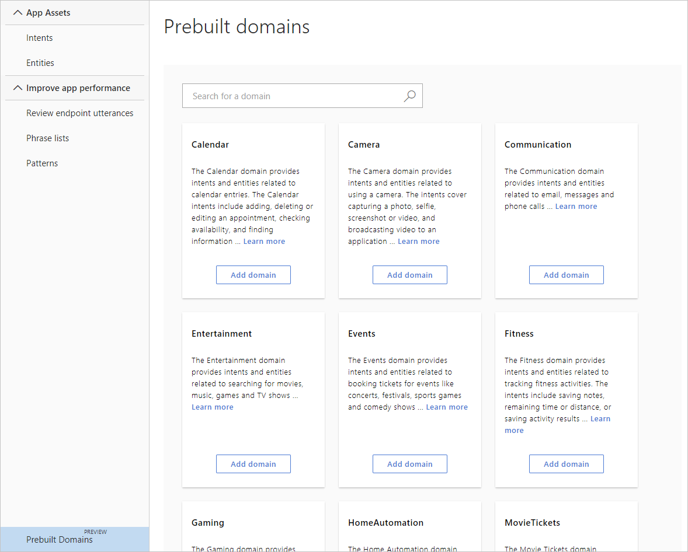
Introducing Intents
Term used to describe the task or action that a user wants to perform
Microsoft also provides a set of prebuilt domains that you can use as intents in your LUIS app

Slide 17
Introducing Utterances
An utterance is best explained as being a phrase or question that a user might utilize to interact with your app
Find outdoor pics
Are there pictures of a train
Show me beach pics
I want to find dog photos

Slide 18
Introducing Entities
The entity represents a word or phrase inside the utterance that you want extracted.
An utterance can include many entities or none at all. An entity represents a class including a collection of similar objects (places, things, people, events or concepts).
Entities describe information relevant to the intent, and sometimes they are essential for your app to perform its task.

Slide 19
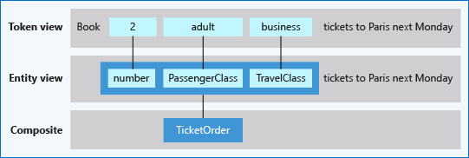
Composite Entity
A composite entity is made up of other entities, such as prebuilt entities, simple, regular expression, list, and hierarchical entities. The separate entities form a whole entity.

Slide 20
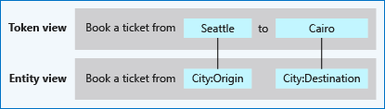
Hierarchical Entity
A hierarchical entity is a category of contextually learned simple entities called children.

Slide 21
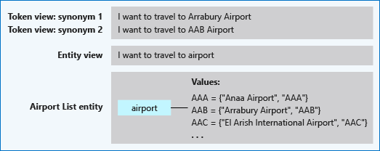
List Entity
Fixed and closed set of related words, including synonyms.

Slide 22
Other Entity Types
Pattern.any
Pattern.any is a variable-length placeholder used only in a pattern's template utterance to mark where the entity begins and ends.
**Example** Given a client application that searches for books based on title, the pattern.any extracts the complete title. A template utterance using pattern.any for this book search is Was {BookTitle} written by an American this year[?].
Prebuilt entity
Prebuilt entities are built-in types that represent common concepts such as email, URL, and phone number. Prebuilt entity names are reserved. All prebuilt entities that are added to the application are returned in the endpoint prediction query if they are found in the utterance.

Slide 23
Other Entity Types, Cont’d
Regular expression entity
A regular expression is best for raw utterance text. It ignores case and ignores cultural variant. Regular expression matching is applied after spell-check alterations at the character level, not the token level. If the regular expression is too complex, such as using many brackets, you're not able to add the expression to the model. Uses part but not all of the .Net Regex library.
Simple entity
A simple entity is a generic entity that describes a single concept and is learned from the machine-learned context. Because simple entities are generally names such as company names, product names, or other categories of names, add a phrase list when using a simple entity to boost the signal of the names used.

Slide 24
Walkthrough – Creating Intents and Utterances

Slide 25

Lab 6: Implement the LUIS Model

Slide 26
Lab Objectives
Create a LUIS Service
Add Intelligence to your LUIS Service
Train and Test the LUIS Service

Slide 27
Lab Scenario
In this lab you will build the logic into a LUIS Service that helps your Bot, which will be integrated later, to search for images in the system.

Slide 28

Next steps
Module Summary
In this module, you have learned about:
Language Understanding
The Microsoft LUIS Service
How to add Logic to a LUIS Service
After the course, consider exploring the scenarios and case studies on the LUIS documentation pages on Microsoft’s Azure Web Site.

